Slide 1

Deep Water
Jo-fai (Joe) Chow
Data Scientist
joe@h2o.ai
@matlabulous
Data Science for IoT Meetup
Barclays Eagle Venture Labs
21st & 24th November, 2016

Slide 2
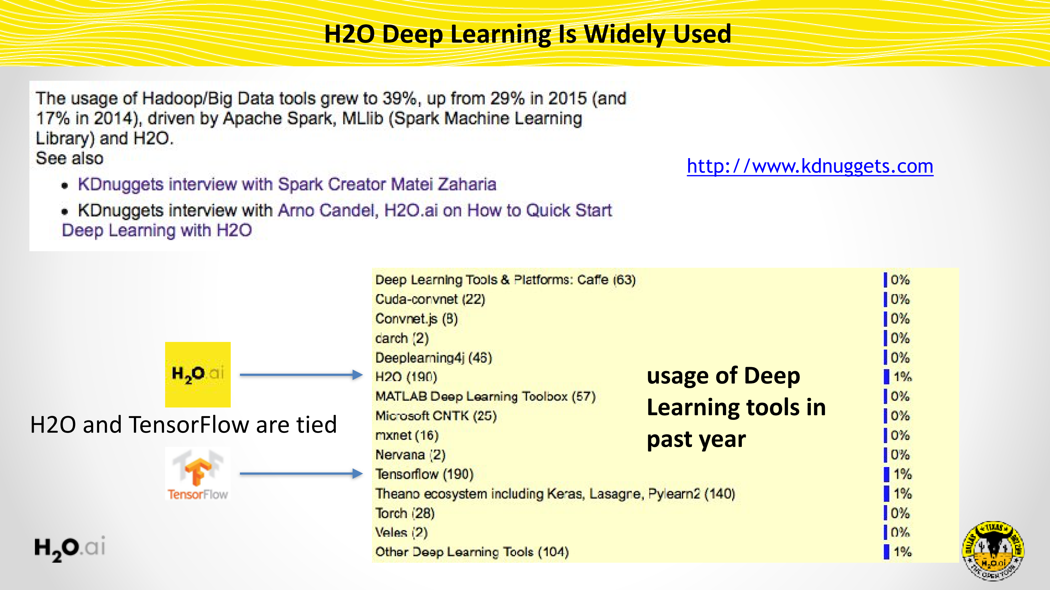

Slide 3
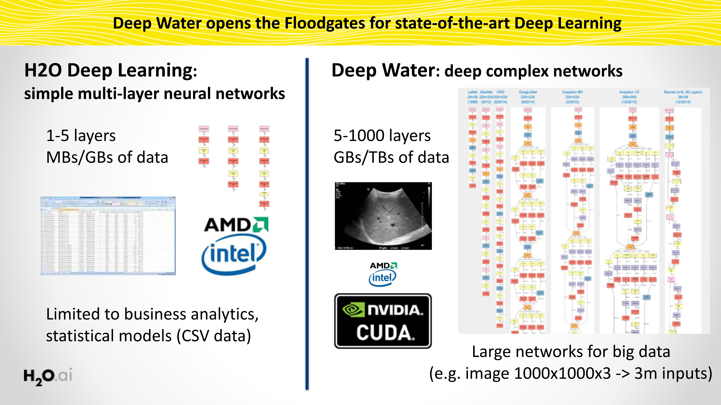
Deep Water opens the Floodgates for State-of-Art Deep Learning
3

Slide 4
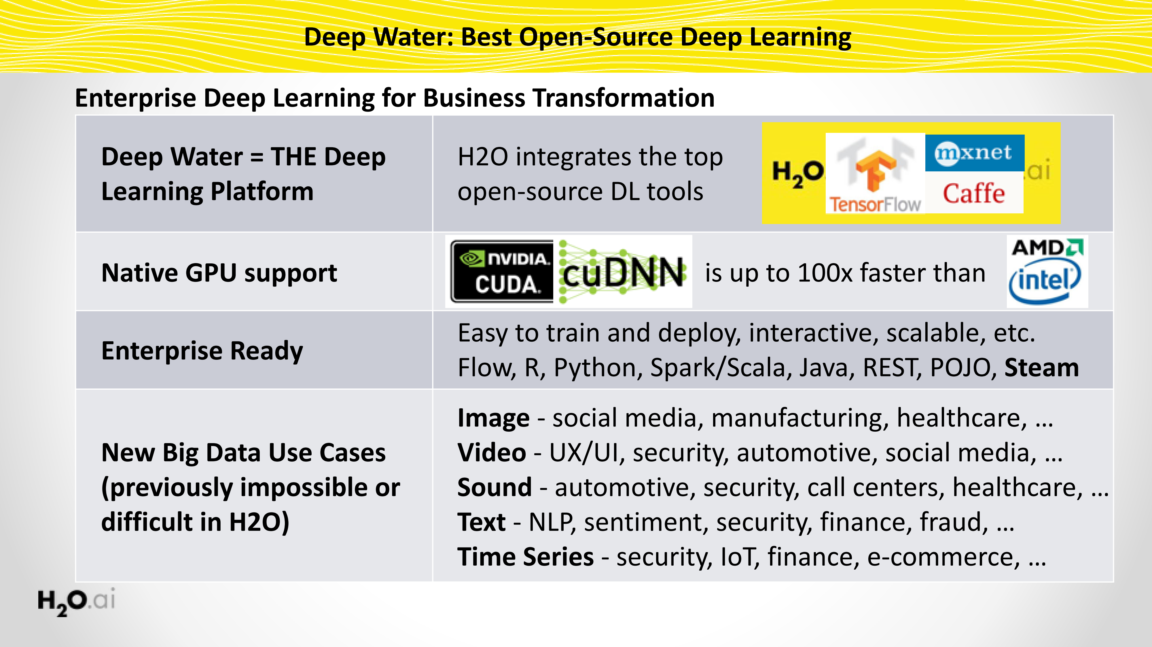
Deep Water: Next-Gen Deep Learning in H2O

Slide 5
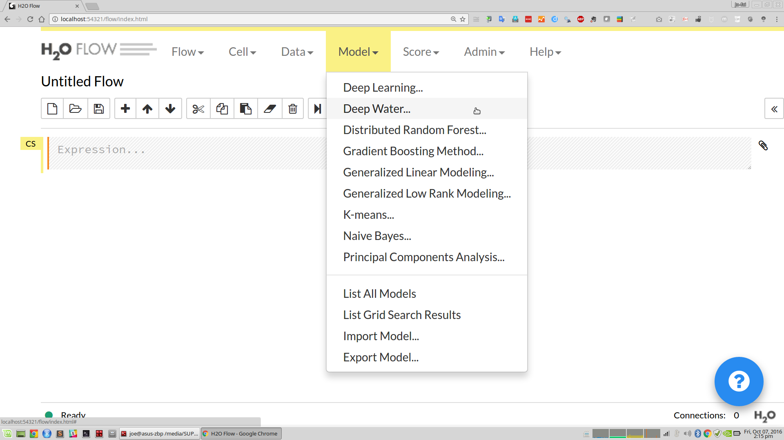
Using Flow to train Deep Water Model

Slide 6
Same H2O R/Python Interface

Slide 7
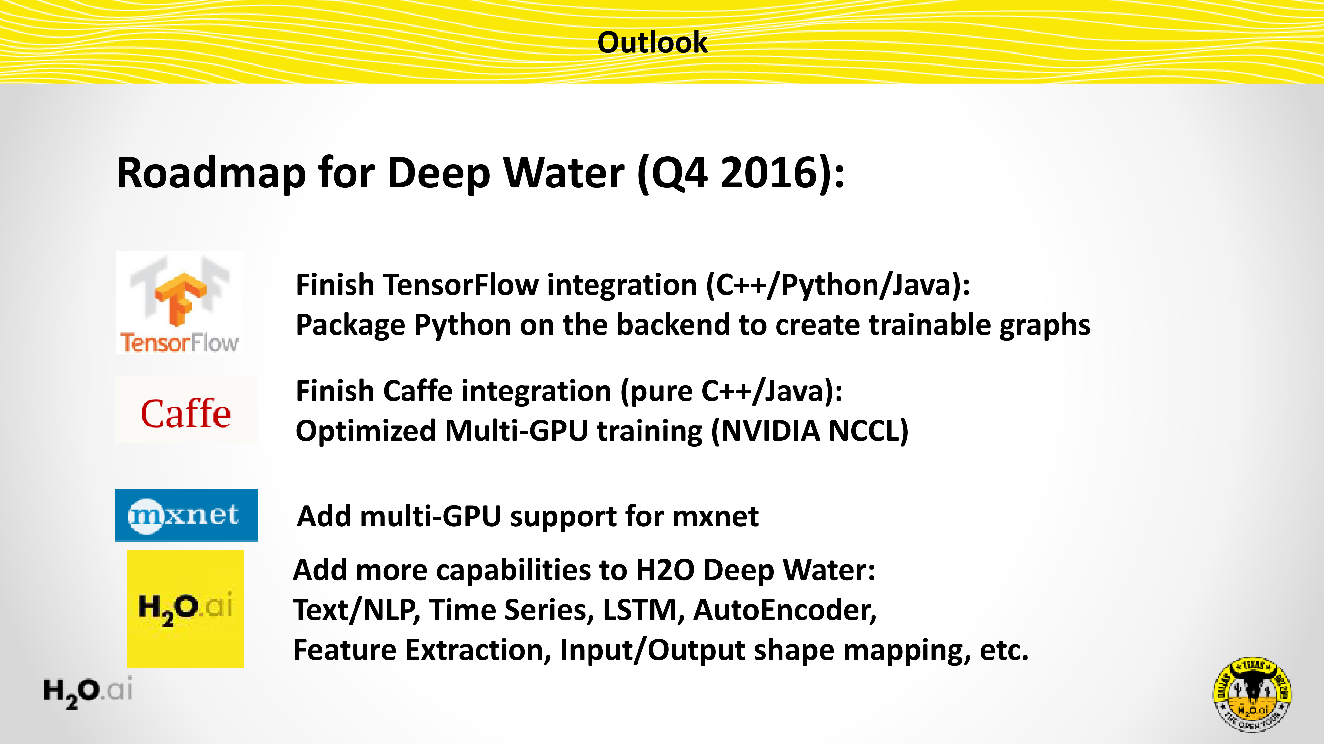

Slide 8
Deep Water Demo

Slide 9
Deep Water Demo
H2O + mxnet / TensorFlow
Datasets:
Cat / Dog / Mouse
Iris
GPU backend
mxnet / TensorFlow
Training a LeNet (CNN) model
Using random grid search for hyper-parameters optimization
Code and Data
github.com/ h2oai/deepwater

Slide 10
Code and References
github.com/h2oai/deepwater

Slide 11
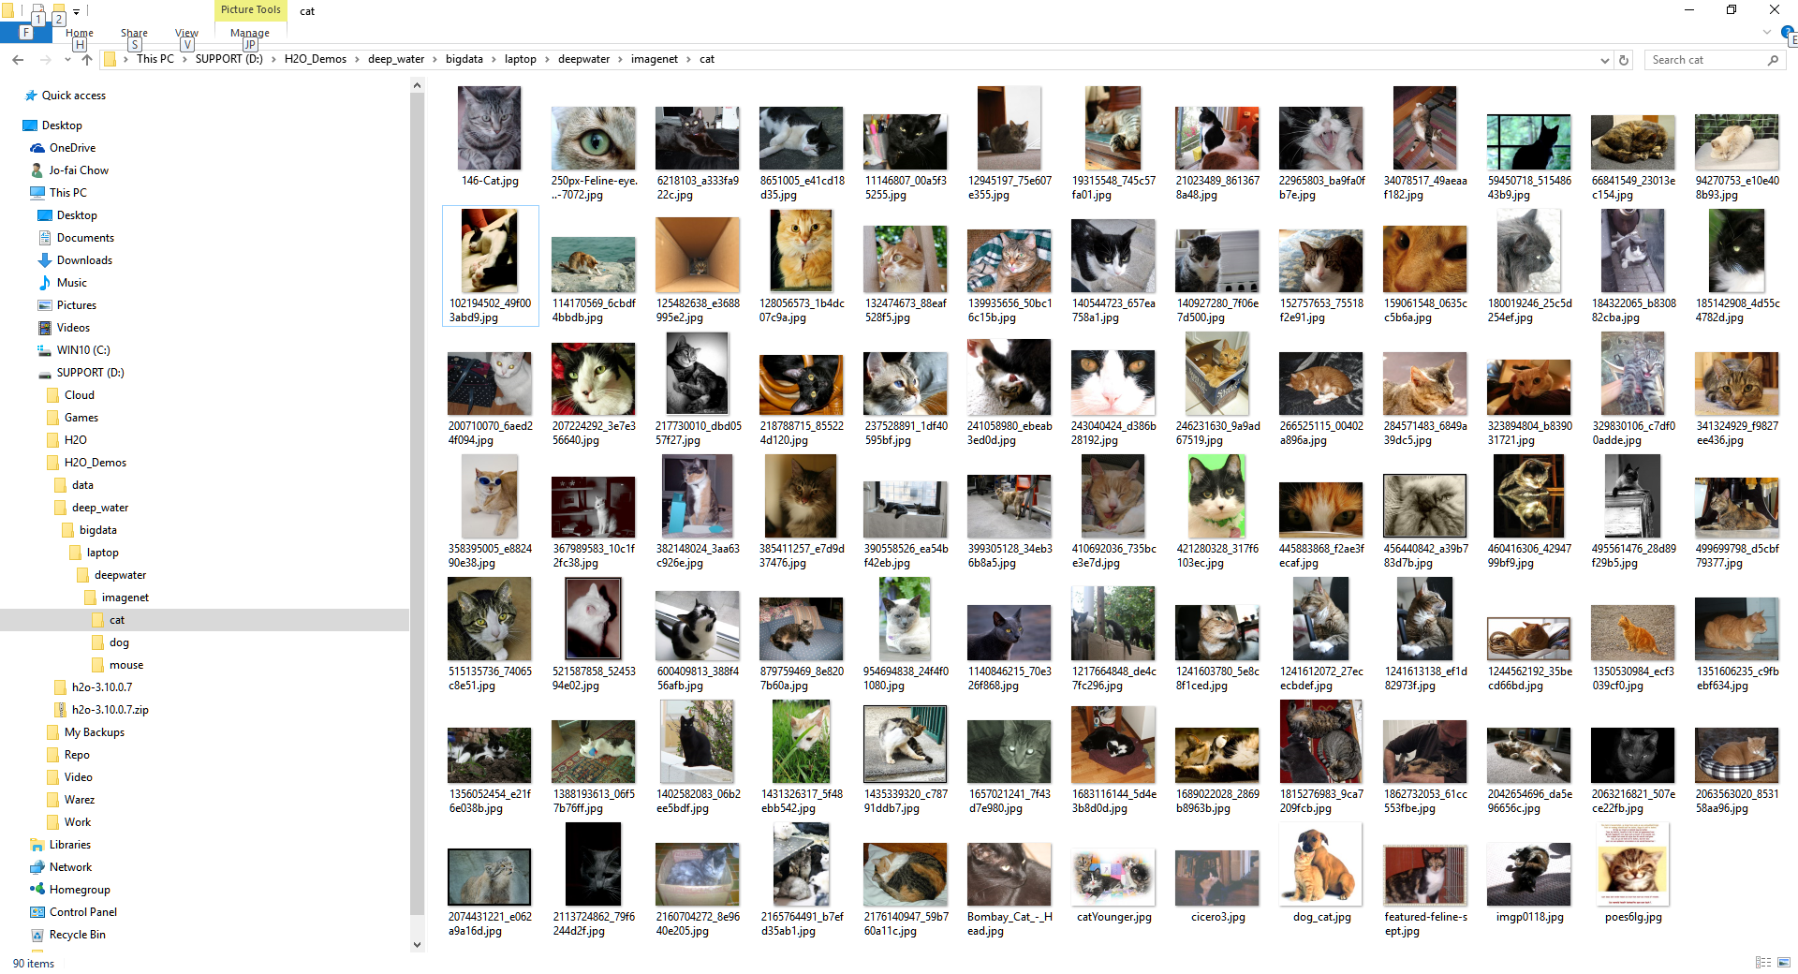
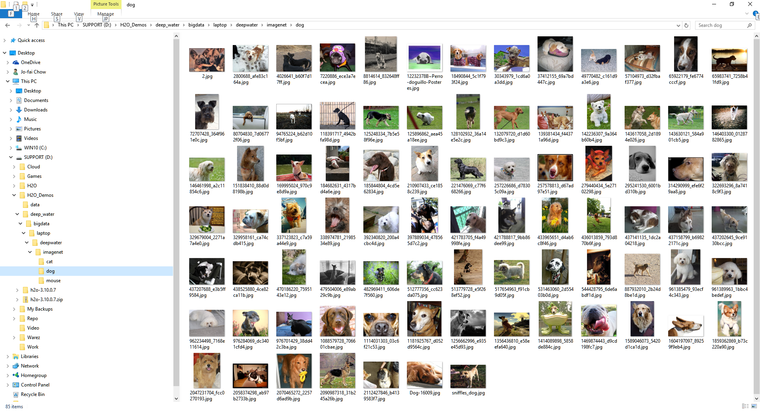
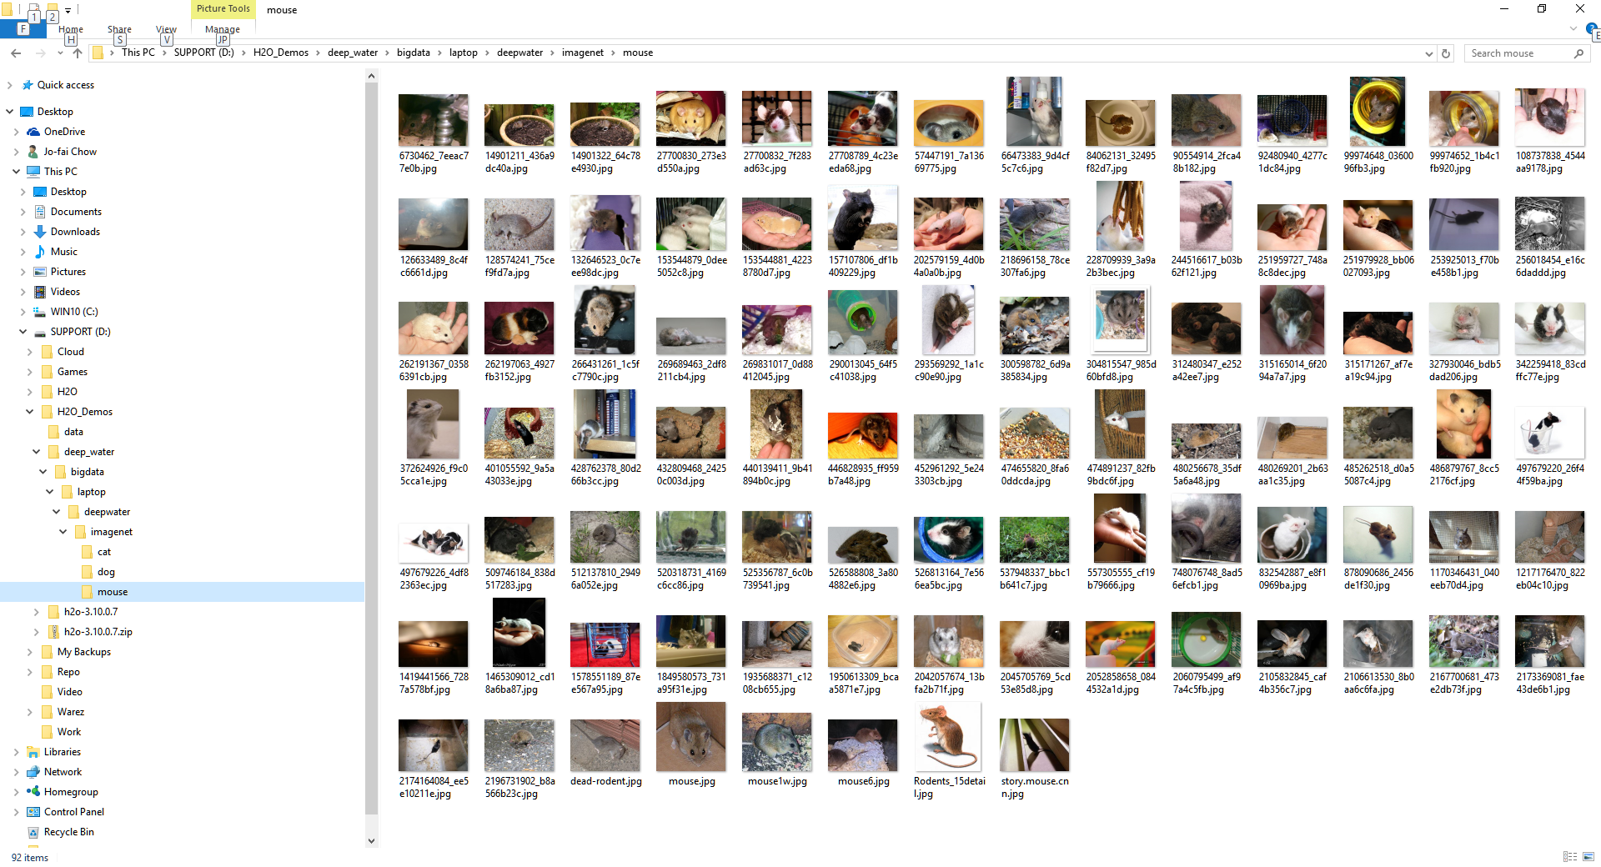
Data – Cat/Dog/Mouse Images

Slide 12
Data - CSV

Slide 13
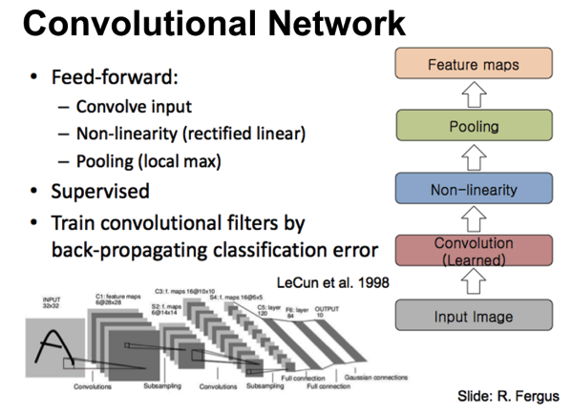
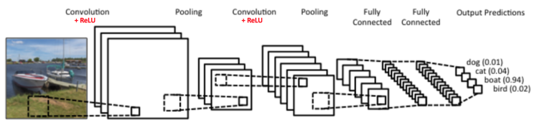
LeNet – Convolutional Neural Network

Slide 14
Deep Water Demo

Slide 15
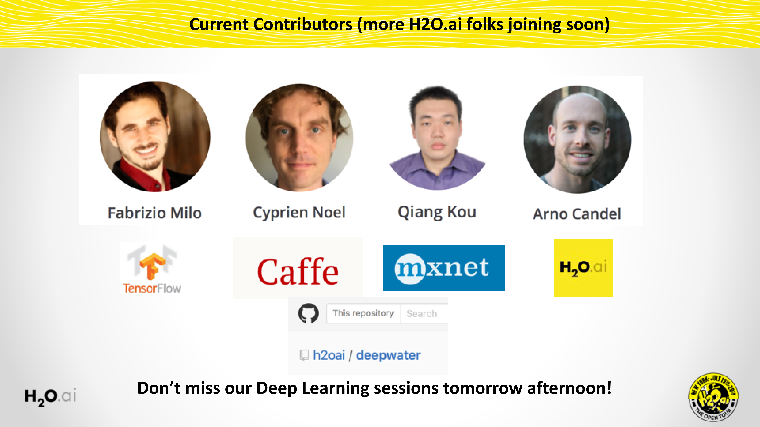
Deep Water opens the Floodgates for State-of-Art Deep Learning
15

Slide 16
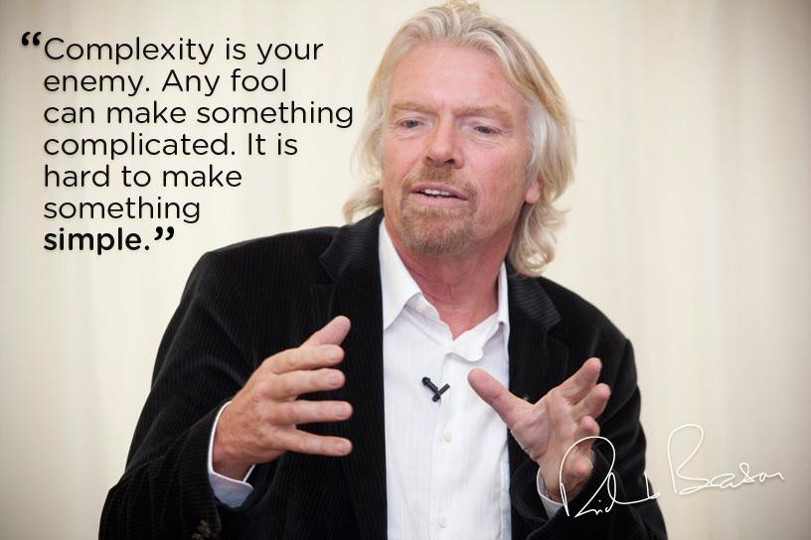
H2O’s Mission
Making Machine Learning Accessible to Everyone
Photo credit: Virgin Media

Slide 17
Thanks!
Organisers & Contributors
Ajit Jaokar
Sibanjan Das
Key Resources
docs.h2o.ai
github.com/h2oai/h2o-meetups
Slides & Code
bit.ly/ h2o_iot_workshop1
Contact
joe@h2o.ai
@matlabulous
github.com/woobe

